Slide 1

JAWAHARLAL NEHRU TECHNOLOGICAL UNIVERSITY ANANTAPUR COLLEGE OF ENGINEERING, KALIKIRI
DEPARTMENT OF ELECTRONICS AND COMMUNICATON ENGINEERING
Final Year Project
on
COMPARISON OF BER OF DIFFERENT CHANNEL CODING TECHNIQUES FOR ADVANCED 5G & 6G NETWORKS
Head of the Department
Dr.K.Aparna,M.Tech.,Ph.D ,
Associate Professor & HECED
Department of ECE
Under the guidance of
BATCH - 07
K . Jayapal Reddy ,M. Tech.,
Assistant Professor (Ad-hoc)
Department of ECE
BATCH-16
PRESENTED BY
Dasari Chandana - 22KA1A0434
Mithaighar Faizia Anjum - 23KA5A0415

Slide 2
LIST OF CONTENTS
Abstract
Introduction
Problem Statement and Objectives
Existing Method
Results of Existing Method
Disadvantages of Existing Method
Proposed Method
Hardware and Software requirements
Block Diagram
Channel Coding Techniques
Implementation and Working Process
Results Overview
Comparison of Existing system and proposed system
Advantages and application of proposed method
Conclusion

Slide 3
ABSTRACT
In wireless communication systems, data transmission is affected by noise, interference, and fading, which increases the Bit Error Rate (BER). Channel coding is an effective technique used to achieve reliable wireless communication with a low error rate. In different generations of wireless communication systems, various channel coding techniques such as, convolutional codes, turbo codes, have been used. However, advanced 5G and 6G communication systems require channel coding methods that provide lower Bit Error Rate (BER) with reduced computational complexity.
This project focuses on comparing the BER performance of different coding techniques such as Convolutional codes, and Low-Density Patity-Check (LDPC) codes.
Simulation results show that LDPC codes provide better BER performance with lower complexity compared to other coding techniques and making it suitable for advanced 5G and 6G networks. For further analysis, turbo codes and polar codes are also implemented, and the performance of all four coding techniques is compared based on BER.

Slide 4
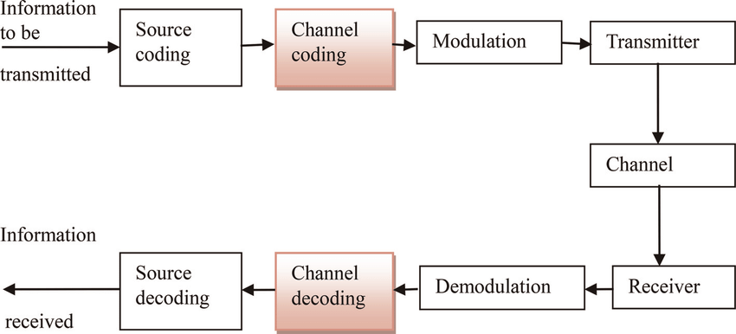
INTRODUCTION
Wireless communication systems are widely used in modern applications such as mobile communication, IoT, and satellite systems. However, during transmission, signals are affected by noise and interference, leading to errors in received data. So, the Channel coding plays a key role in improving data reliability by adding redundancy to the transmitted data.With the rapid evolution of mobile communication from 1G to 5G, there is a strong demand for high data rates, better Quality of Service (QoS), and efficient use of available bandwidth. In next-generation 6G systems, achieving high reliability and low latency is very important.
Fig: Block Diagram of Digital Communication System

Slide 5
Problem Statement
In wireless communication systems, signal transmission is affected by noise, interference, and channel fading, which increases the Bit Error Rate (BER).
As communication systems evolve towards 6G, there is a demand for:
Ultra-reliable communication
High data rates
Low latency
Different channel coding techniques provide different levels of performance and complexity.
Therefore, it is necessary to analyze and compare these techniques to identify the most efficient method that minimizes BER while maintaining system efficiency.
Objectives
To design a communication system model
To study different channel coding techniques
To simulate the system using MATLAB
To analyze BER performance of different techniques
To identify the best coding technique for advanced 5G 6G networks

Slide 6
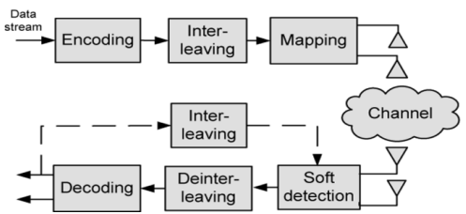
Existing Method:
The existing system uses a MIMO-OFDM communication framework, where Orthogonal Frequency Division Multiplexing (OFDM) divides high data rate signals into multiple low-rate subcarriers to improve spectral efficiency and reduce inter-symbol interference. To further enhance performance, Multiple-Input Multiple-Output (MIMO) technology is used.
Fig: Block Diagram of Existing Method

Slide 7
Some related pictures
The system processes data through encoding, interleaving, modulation, transmission over a noisy channel, and decoding at the receiver. Although this approach improves performance and reduces errors, it has limitations in handling noise efficiently and achieving very low Bit Error Rate (BER) required for advanced 5G and 6G communication systems.
The relationship between data rate and symbol duration is given by:
R = 1 / Tsym
Where:
R = Data rate (symbols per second)
Tsym = Symbol duration (time taken to transmit one symbol)

Slide 8
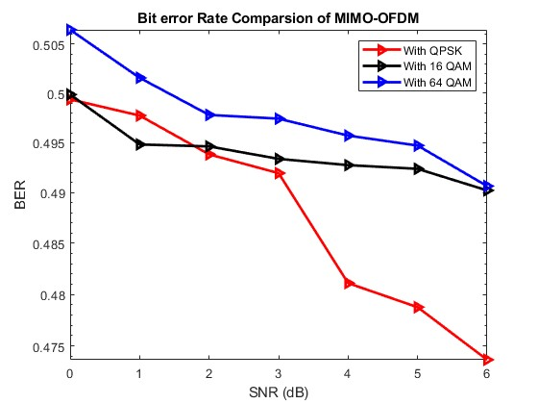
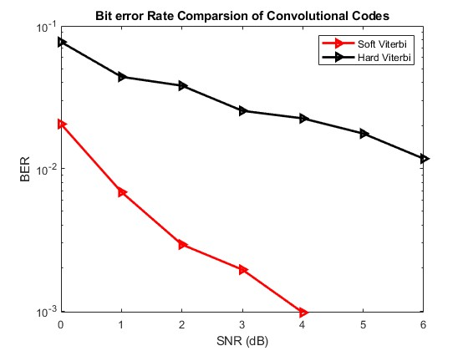
RESULTS OF EXISTING SYSTEM
The graph shows the BER performance of the MIMO-OFDM system using QPSK, 16-QAM, and 64-QAM. As SNR increases, BER decreases for all modulation techniques. QPSK provides better performance with lower BER, while 64-QAM has higher BER due to noise sensitivity. This shows a trade-off between data rate and error performance.
The graph shows the BER performance of convolutional codes using hard and soft Viterbi decoding. Soft Viterbi decoding provides lower BER compared to hard decoding. As SNR increases, BER decreases in both cases. Soft decoding performs better as it uses probability information instead of binary decisions.

Slide 9
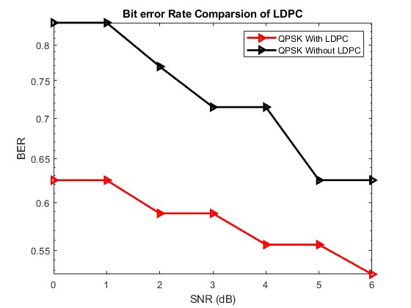
The graph shows the BER performance of the system with and without LDPC coding. It is observed that LDPC coding provides lower BER compared to the uncoded system. As SNR increases, BER decreases in both cases. LDPC improves error correction and enhances system reliability, especially at low SNR conditions.
From the above results, it is observed that system performance improves as SNR increases. Advanced techniques like LDPC and soft Viterbi decoding reduce BER compared to basic methods. However, the existing system still cannot achieve very low BER under all conditions, indicating the need for more efficient coding techniques.

Slide 10
DISADVANTAGES OF EXISTING SYSTEM
High computational complexity
Poor performance at low SNR (high BER)
Higher-order modulation (64-QAM) is noise-sensitive
Hard Viterbi decoding gives lower performance
LDPC does not achieve very low BER in all cases
Increased system complexity due to MIMO
Requires accurate synchronization
Does not reach Shannon limit performance

Slide 11
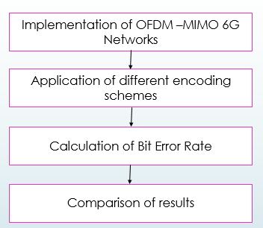
Proposed Method:
The proposed system integrates MIMO-OFDM technology with advanced channel coding techniques such as Convolutional, Turbo, LDPC, and Polar codes to improve communication performance. It is designed to achieve low Bit Error Rate (BER), high spectral efficiency, and low latency, which are essential for 5G and 6G systems. The system starts with random binary data, which is encoded, interleaved, and modulated using QPSK/QAM, and then transmitted through a MIMO-OFDM system over an AWGN channel. At the receiver, soft detection, deinterleaving, and decoding are performed to recover the original data. Finally, BER is calculated and compared for different coding techniques to determine the most efficient method.
.
Figure : Flow Chart of Proposed Method

Slide 12
Hardware & Software Requirements
Software: Matlab R2022b
Hardware:
Operating Systems:
• Windows 10
RAM:
Minimum: 4 GB
Recommended: 8 GB

Slide 13
Block Diagram:
Random Binary Data Source
Channel Encoder (Conv / Turbo / LDPC / Polar)
Modulator (QPSK / QAM)
MIMO-OFDM System
BER Calculation (Error Analysis)
Channel Decoder (Conv / Turbo / LDPC / Polar)
Demodulator
AWGN Channel (Noise Addition)
Fig : Block Diagram of Proposed System

Slide 14
METHODOLOGY
The proposed system is implemented using MATLAB simulation to evaluate the performance of different channel coding techniques.
The methodology consists of the following steps:
Generate random binary input data
Apply channel coding techniques:
Modulate the encoded data using QPSK / QAM
Transmit the signal through a noisy channel (AWGN)
Demodulate the received signal
Decode the signal using respective decoding algorithms
Calculate Bit Error Rate (BER)
Plot BER vs SNR graph for comparison
Convolutional Coding
LDPC Coding
Turbo Coding
Polar Coding

Slide 15
Channel Coding Techniques
1. CONVOLUTIONAL CODES
Convolutional codes are widely used error-correcting codes in communication systems, where the output depends on both present and past input bits. They use shift registers and generator polynomials to add redundancy, enabling error detection and correction.
Formula:
R = k/n
2. LDPC CODES
LDPC (Low-Density Parity-Check) codes are advanced error-correcting codes that use a sparse parity-check matrix for efficient encoding and decoding. They provide very low BER and performance close to the Shannon limit, making them suitable for 5G and modern communication systems.
Formula:
H * c^T = 0

Slide 16
3. TURBO CODES
Turbo codes are powerful error-correcting codes that use two convolutional encoders and an interleaver to improve performance. The interleaver rearranges input bits, reducing burst errors. Turbo codes achieve very low BER and performance close to the Shannon limit, but they have higher latency and complexity.
Formula:
LLR = log ( P(y|x=1) / P(y|x=0) )
4. POLAR CODES
Polar codes provide low latency, high spectral efficiency, and excellent performance, making them suitable for next-generation (5G & 6G) systems, though they involve higher complexity. The channels are divided into reliable and unreliable channels, where reliable channels carry information bits and others are assigned frozen bits to improve error correction.
Formula:
x = u * G_N

Slide 17
IMPLEMENTATION & WORKING PROCESS
The system is implemented in MATLAB using a MIMO-OFDM communication model
Random binary data is generated and encoded using Convolutional, Turbo, LDPC, and Polar codes to add redundancy for error correction
Encoded data is interleaved to reduce burst errors and then modulated using QPSK/QAM, converting bits into symbols
In OFDM processing, IFFT converts signals to time domain and a cyclic prefix is added to reduce inter-symbol interference
The signal is transmitted using MIMO antennas, improving data rate, capacity, and reliability, and passes through an AWGN channel
At the receiver, cyclic prefix removal, FFT, and signal detection (ZF/MMSE) are performed to recover the transmitted signal
The signal is then demodulated, deinterleaved, and decoded using respective decoding techniques to retrieve original data
Finally, BER is calculated to evaluate and compare the performance of different coding techniques under varying SNR conditions
BER = Number of Error Bits / Total Number of Bits

Slide 18
Results Overview
BER decreases as SNR increases. QPSK shows lowest BER, while 64-QAM has higher BER due to noise sensitivity. Lower-order modulation is more reliable.
Soft Viterbi decoding gives lower BER than hard decoding. BER decreases with SNR. Soft decoding improves performance using probability information.

Slide 19
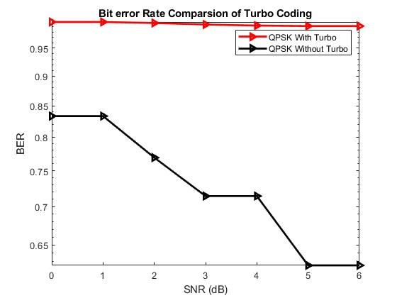
LDPC significantly reduces BER compared to without coding. Performance improves as SNR increases, showing strong error correction capability.
Turbo coding improves BER gradually with SNR. It provides good error correction but has higher complexity and latency due to iterative decoding.

Slide 20
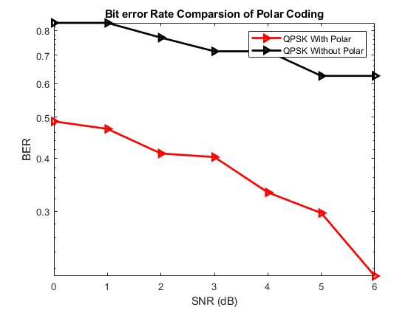
Polar coding shows the best performance with lowest BER. BER decreases rapidly with SNR, making it suitable for 5G and 6G systems.
From the proposed system graphs, it is observed that Advanced channel coding techniques significantly enhance performance. Soft Viterbi decoding, LDPC, and Turbo codes improve error correction, while Polar coding shows the best performance with the lowest BER, low latency, and high efficiency, making it most suitable for advanced 5G and 6G communication systems.

Slide 21
COMPARISON OF EXISTING AND PROPOSED SYSTEM
Feature | Existing System | Proposed System
Coding Techniques | Convolutional, LDPC | Turbo, Polar
BER Performance | Moderate | Very Low
Latency | Higher | Lower
Spectral Efficiency | Limited | High
Performance at Low SNR | Less efficient | More efficient
Complexity | Moderate | Higher but optimized
Reliability | Moderate | High
Suitability for 5G/6G | Not Suitable | Highly Suitable

Slide 22
SUITABILITY OF CODING TECHNIQUES FOR COMMUNICATION SYSTEMS
Coding Technique | Suitable Communication Systems
Convolutional Coding | 2G, 3G systems, basic wireless communication, satellite communication
LDPC Coding | 4G LITE and Wi-Fi systems
Turbo Coding | 5G Systems, deep space communication, mobile networks
Polar Coding | Advanced 5G control channels, advanced wireless systems, future 6G networks

Slide 23
Advantages and Applications of Proposed Method
Advantages
Reduced Bit Error Rate (BER)
Improved reliability and error correction
High spectral efficiency using MIMO-OFDM
Better performance at low SNR
Low latency with Polar coding
Supports high data rate communication
Applications
5G and 6G communication systems
Mobile and wireless networks
Satellite communication
IoT and Wireless Sensor Networks
High-speed data transmission
Military and secure communication

Slide 24
CONCLUSION
This project analyzes different channel coding techniques such as Convolutional, Turbo, LDPC, and Polar codes using a MIMO-OFDM system. The results show that the proposed system, which includes advanced coding techniques like Turbo and Polar codes, achieves improved performance in terms of reduced Bit Error Rate (BER), better reliability, and higher spectral efficiency compared to the existing system. Among all techniques, Polar coding provides the best performance due to its low latency and efficiency, making it suitable for advanced 5G and 6G communication systems. Overall, the proposed system enhances communication performance and offers a reliable solution for next-generation wireless networks.
The study also demonstrates the importance of advanced error correction techniques in improving system efficiency. It highlights the need for low latency and high data rate communication in modern wireless systems.

Slide 25
References
[1] S. Bates et al., “Termination sequence generation circuits for LDPC convolutional codes,” IEEE Trans., 2005.
[2] S. Bates et al., “Decoders for LDPC convolutional codes,” NASA VLSI Symposium, 2005.
[3] S. M. Motaghiannezam et al., “High-speed PAM4 transmission,” OFC Conference, 2016.
[4] Additional MATLAB and communication system resources

Slide 26
THANK YOU

